Slide 1
Natural Language Commands to a Robot Control System Automatically
Submitted For
Annajiat Alim Rasel
CSE-712:Symbolic Machine Learning II
Brac University
Submitted by
Ayesha Akter-21166014

Slide 2
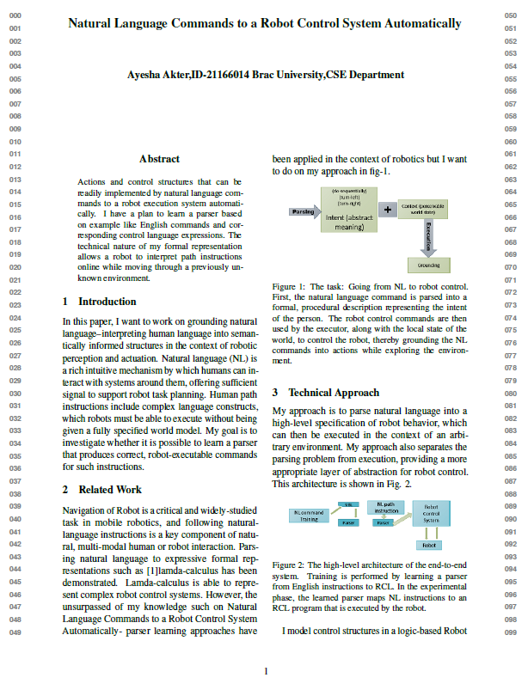
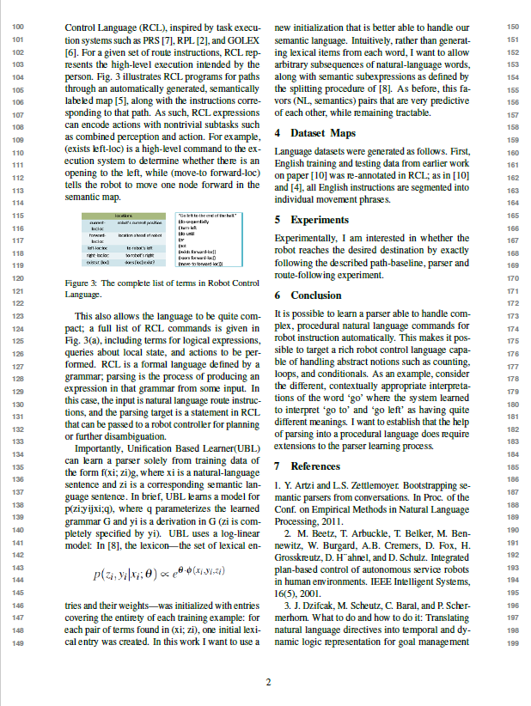
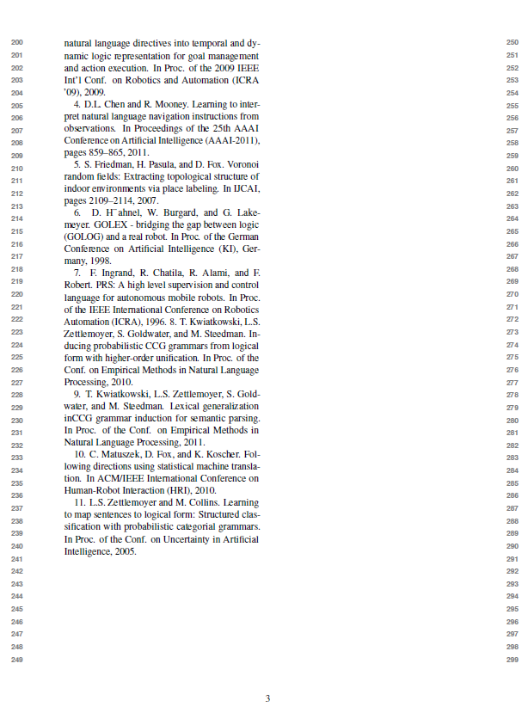

Slide 3
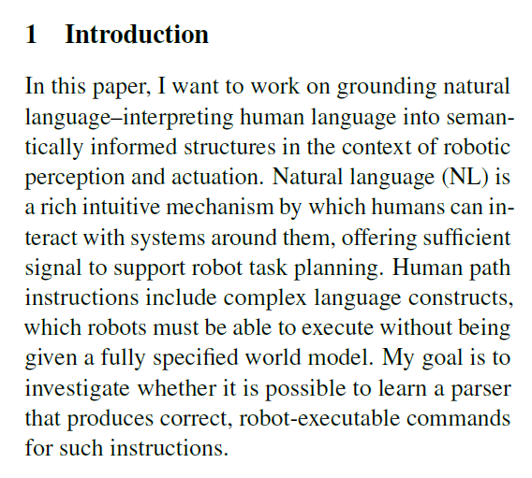
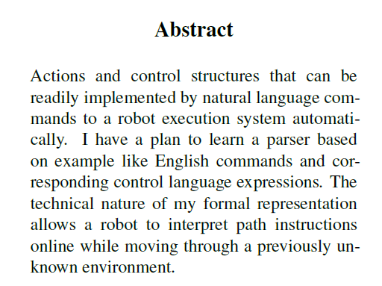
Natural Language Commands to a Robot Control System Automatically

Slide 4
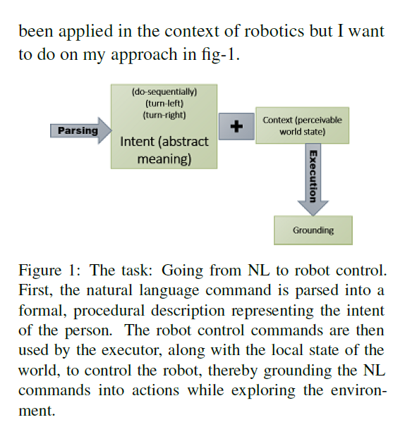
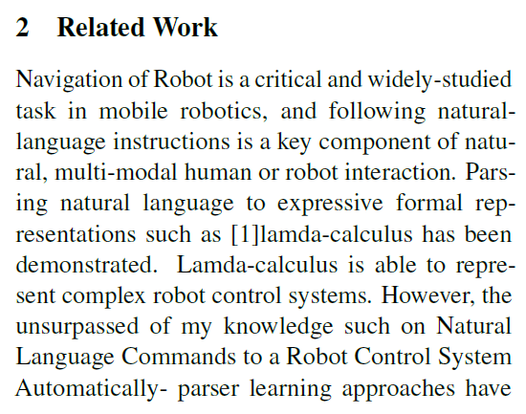
Natural Language Commands to a Robot Control System Automatically

Slide 5
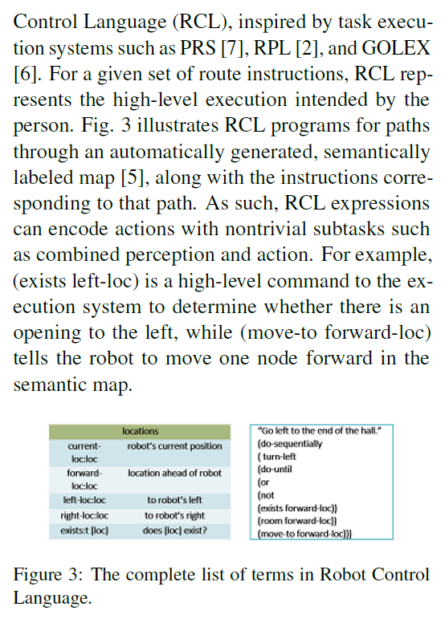
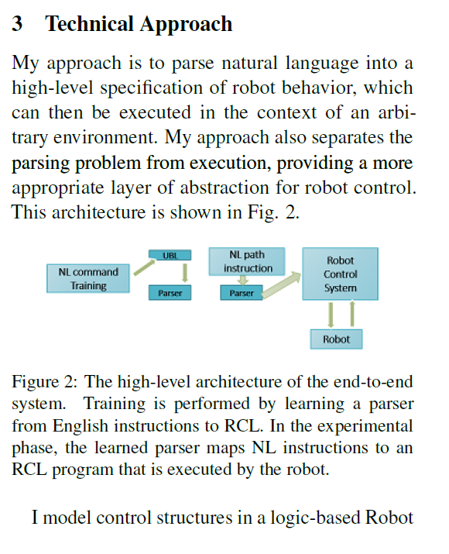
Natural Language Commands to a Robot Control System Automatically

Slide 6
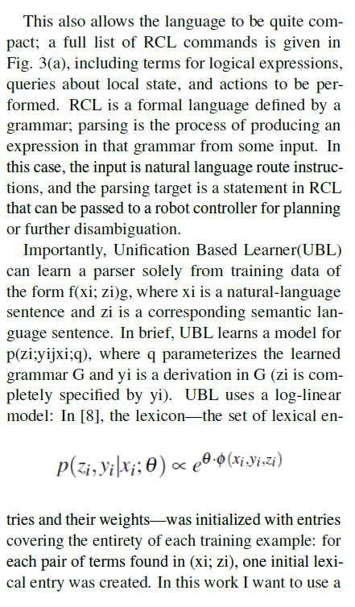
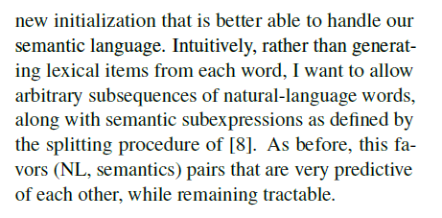
Natural Language Commands
to a Robot Control
System Automatically
3 . Technical Approach . . . . .

Slide 7
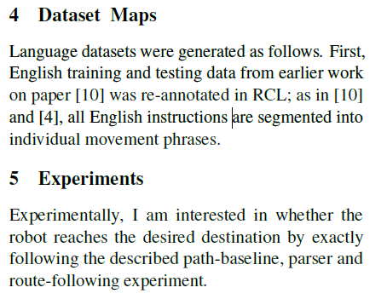
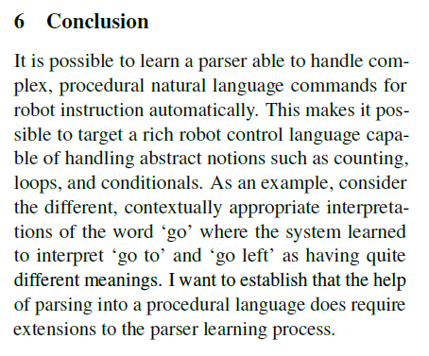
Natural Language Commands to a Robot Control System Automatically

Slide 8
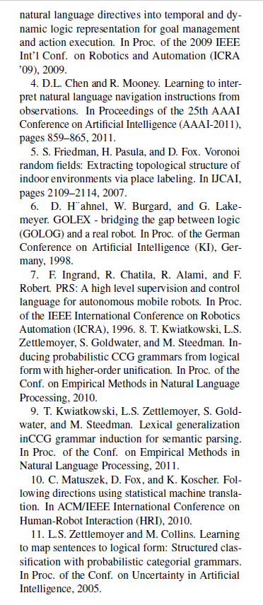
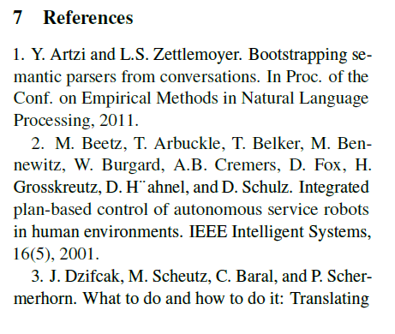
Natural Language Commands
to a Robot Control
System Automatically

